Slide 1
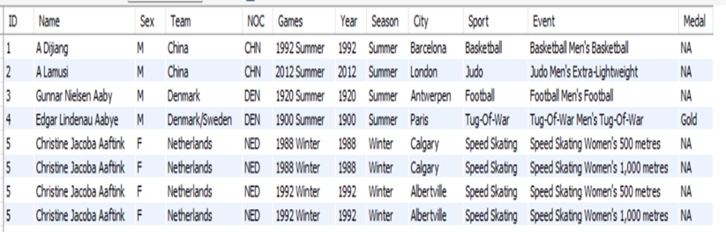
MySQL PROJECT (OLYMPIC RECORDS)
The dataset consists of two csv files namely ‘athlete_events’ and ‘noc_regions’
athlete_events: It consists of 25732 rows and 12 columns. The original file consisted of many more records but due to some error I was able to import only these many rows.

Slide 2
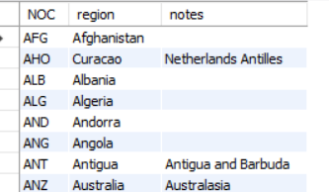
MySQL PROJECT (OLYMPIC RECORDS)
noc_regions: It consists of 230 rows and 3 columns
Column name ‘NOC’ is the common column between both the tables
Twelve questions have been formed which would be useful to obtain certain records related to the Olympic Games

Slide 3


How many Olympic games have been held?
QUERY
SOLUTION

Slide 4

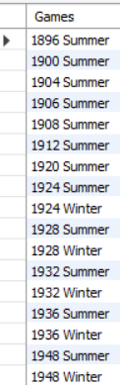
List down all the Olympic games held so far
QUERY
SOLUTION (Showing few records only)

Slide 5
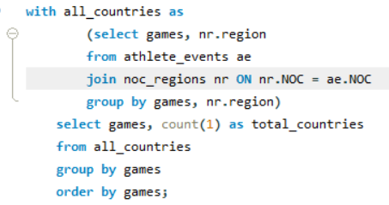
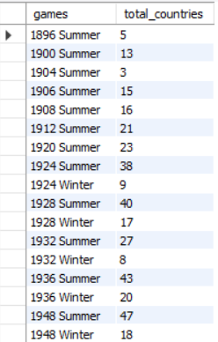
List down the total number of countries who participated in each Olympic game
QUERY
SOLUTION (Showing few records only)

Slide 6
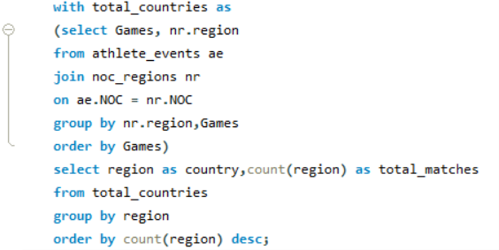
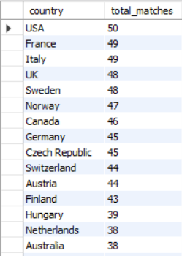
Find out the participation of countries in the Olympic games
QUERY
SOLUTION (Showing few records only)

Slide 7
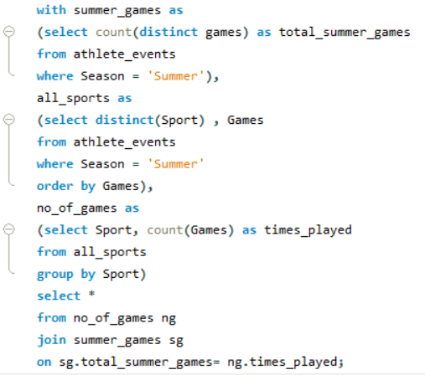

Identify the sport which was played in all summer Olympics
QUERY
SOLUTION

Slide 8
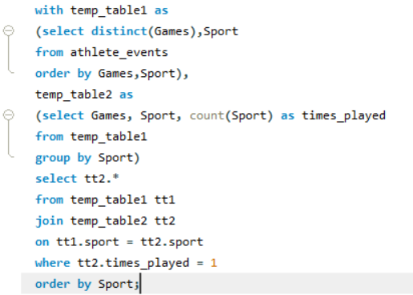
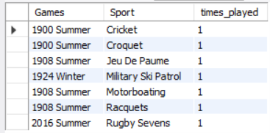
Which sport was played only once in the Olympics
QUERY
SOLUTION

Slide 9
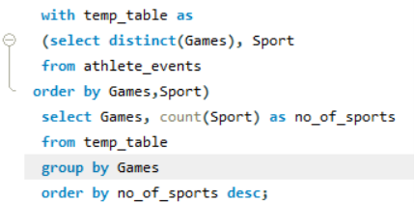
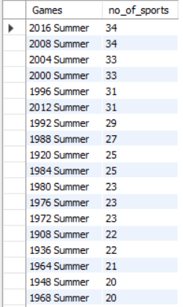
Fetch the total number of sports played in each Olympic game
QUERY
SOLUTION (Showing Few Records Only)

Slide 10
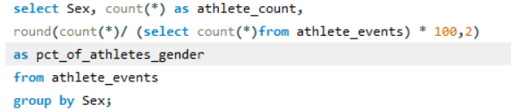
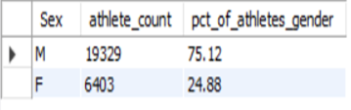
Find the percentage of male and female athletes who participated in all Olympic games
QUERY
SOLUTION

Slide 11
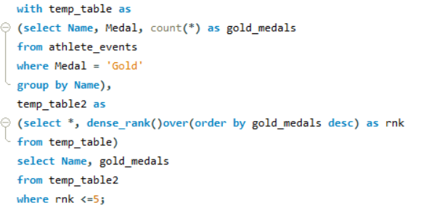
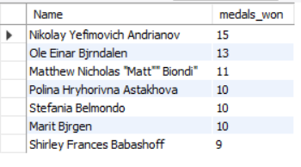
Fetch the top 5 athletes who have won the most gold medals
QUERY
SOLUTION

Slide 12
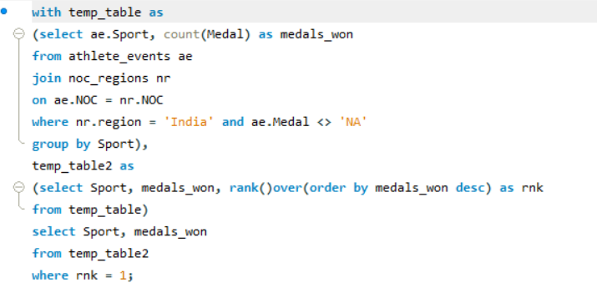

In which Sport, India has won highest medals
QUERY
SOLUTION

Slide 13
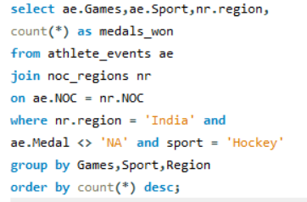
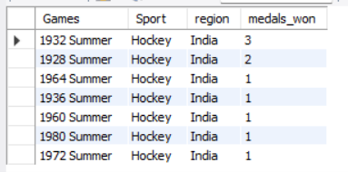
Break down all Olympic games where India won medal for Hockey and how many medals in each Olympic games
QUERY
SOLUTION

